Slide 1


Message Aggregation in SAP CPI
June 2021

Slide 2
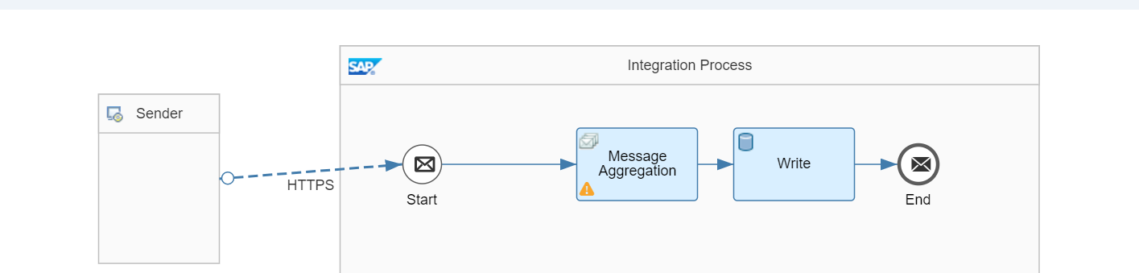
Integration Flow
Aggregator in SAP CPI is useful to combine multiple incoming messages into a single message for processing it to receiver.
It collects the each individual messages until a complete set of related messages has been received.
On successful receipt of the messages, aggregator publishes a single file(aggregated on some principle)

Slide 3
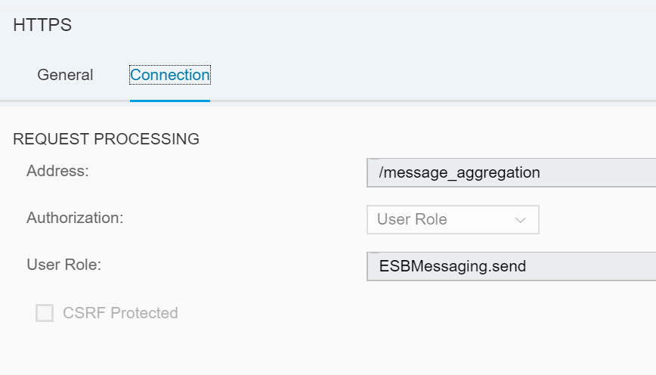
Message Aggregator: Configuration of Sender Channel
Configure the Sender channel from Source system to Start Node with HTTPS adapter.
Configure the Address which should be unique for identification of iFlow.
Configure the User Role as ESBMessaging.send, This role should be necessary for user to trigger.

Slide 4
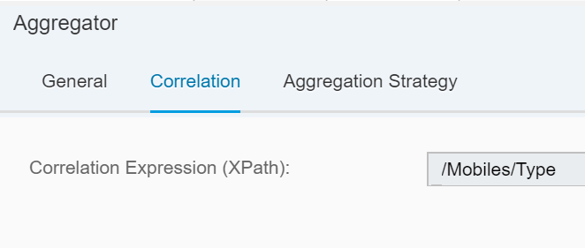
Configuring Aggregator
Correlation: This XPath expression is important as to identify an element based on which incoming messages should be correlated
The Aggregator step generates an SAP Process Integration multi mapping with specific format.

Slide 5
Contd..1
Incoming Format: Till current release, only XML format supported. It is important that incoming messages should be in same format.
Aggregation Algorithm: 2 options are supporting Combine and Combine in Sequence
1. Combine: All the incoming messages will be correlated but we cannot ensure the original messages will be in sequence.
2. Combine in Sequence: Aggregated message contains all correlated incoming messages, and the original messages are put into a sequence.
Message Sequence Expression: Enter an XPath expression for that message element based on which a sequence is being defined. You can use only numbers to define a sequence. Each sequence starts with 1.
Last Message Condition: Define the condition (XPATH = value) to identify the last message of an aggregate.
Completion Timeout: Defines the maximum time between two messages before aggregation is being stopped (period of inactivity).
Data Store Name: Enter the name of Data store where the aggregated message can be stored while processing.

Slide 6
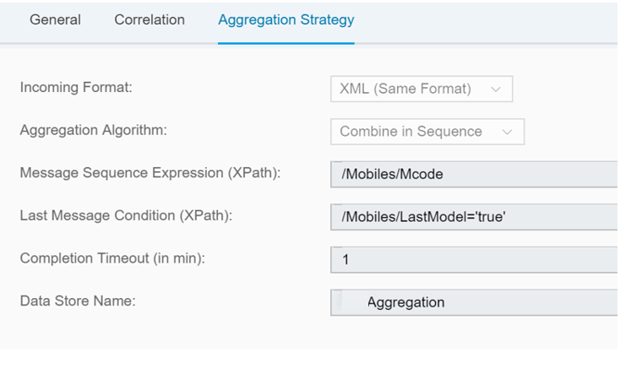
Contd..2
Configure the Aggregation Strategy as per the previous slide.

Slide 7
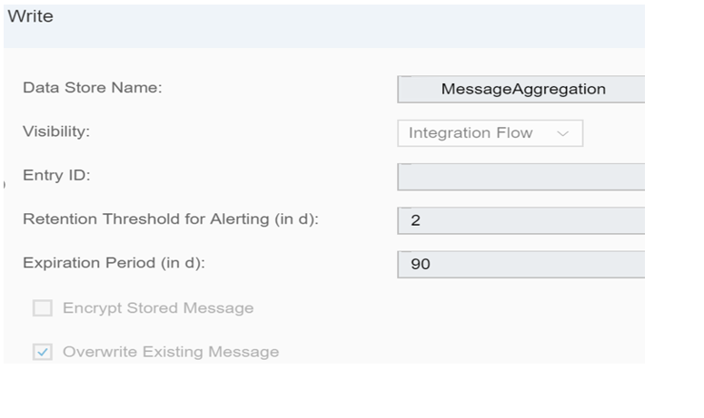
Data Store - Write
Select the Write Data store from Palate place it after Aggregator step for persisting aggregated message.

Slide 8
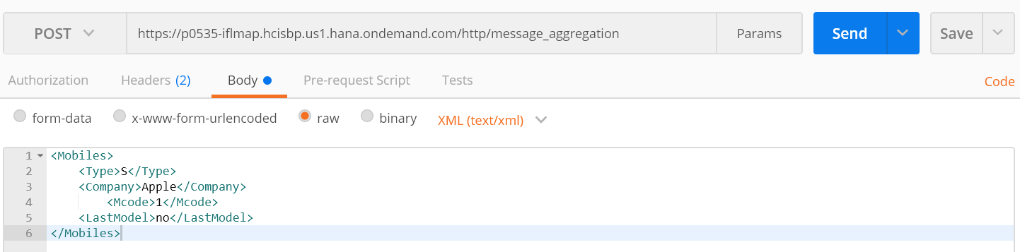
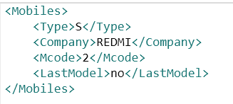
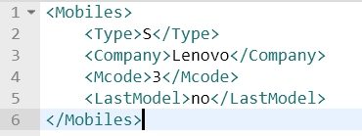
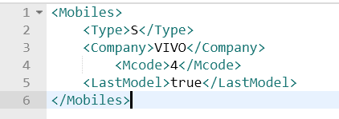
Test - Postman

Slide 9
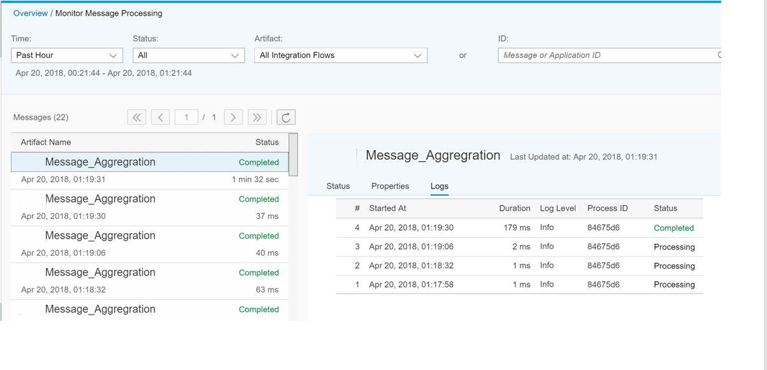
Message Monitoring

Slide 10
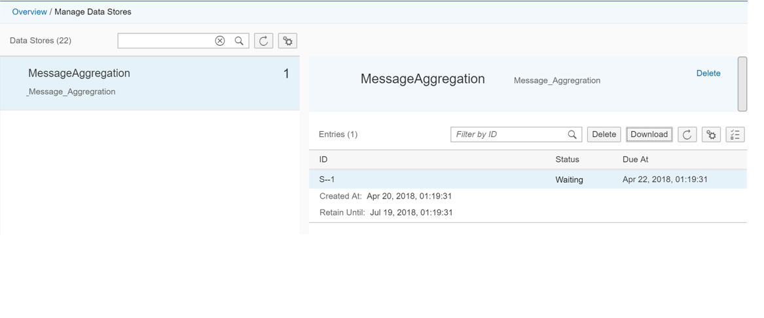
Payload Entry in Datastore

Slide 11
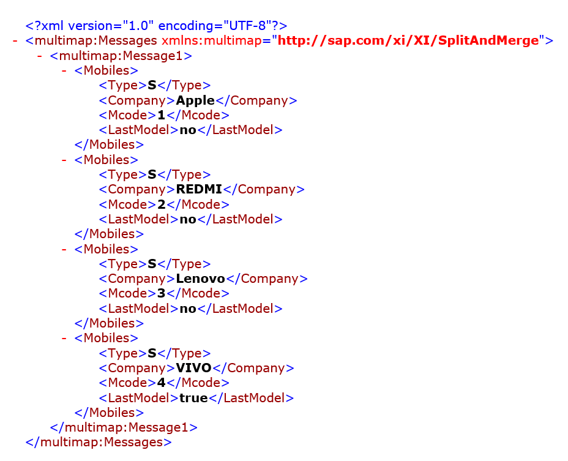
Aggregated Message

Slide 12

About Deloitte Deloitte refers to one or more of Deloitte Touche Tohmatsu Limited, a UK private company limited by guarantee, and its network of member firms, each of which is a legally separate and independent entity. Please see www.deloitte.com/about for a detailed description of the legal structure of Deloitte Touche Tohmatsu Limited and its member firms. Please see www.deloitte.com/us/about for a detailed description of the legal structure of Deloitte LLP and its subsidiaries. Certain services may not be available to attest clients under the rules and regulations of public accounting. Copyright © 2019 Deloitte Development LLC. All rights reserved. 36 USC 220506 Member of Deloitte Touche Tohmatsu Limited
Notes:
12

